Slide 1
Contents
Image Segmentation
Fundamentals
Region Based Segmentation
Thresholding
Otsu Thresholding
Hough Transform
WaterShed Segmentation

Slide 2
Region based Segmentation

Slide 3
Image Segmentation
Definition
Need of Segmentation
Classification of Methods
Region based Segmentation

Slide 4
Image Segmentation
Segmentation refers to the process of partitioning a image into multiple regions.
Regions:- A group of connected pixels with similar properties.
Regions are used to interpret images.
A region may correspond to a particular object, or different parts of an object.

Slide 5
In most cases, segmentation should provide a set of regions having the following properties.
Connectivity and compactness
Regularity of boundaries
Homogeneity in terms of color or texture
Differentiation from neighbor regions

Slide 6
Need of Segmentation / Motivation
The goal of segmentation is to simplify the representation of an image into something that is more meaningful and easier to analyze.
Image segmentation is typically used to locate objects and boundaries in images.
For correct interpretation, image must be partitioned into regions that correspond to objects or parts of an object.

Slide 7
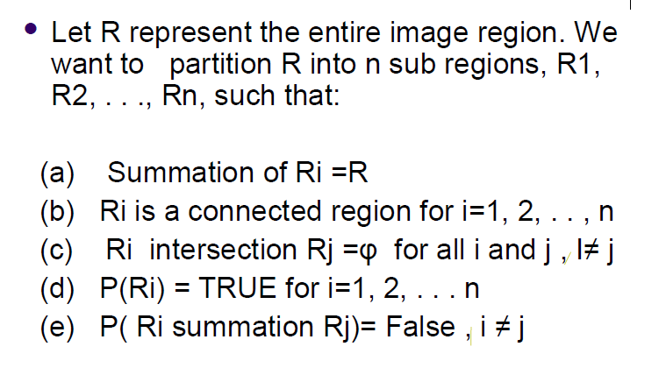
Representation

Slide 8
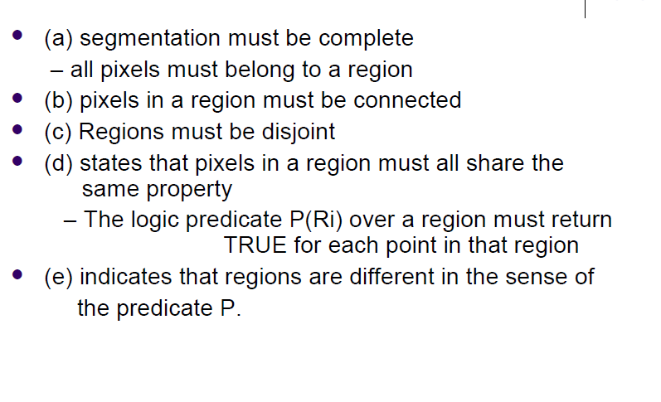
Meaning of Representation

Slide 9
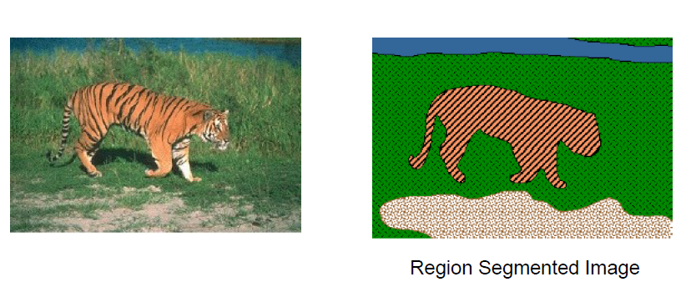
Image Segmentation

Slide 10
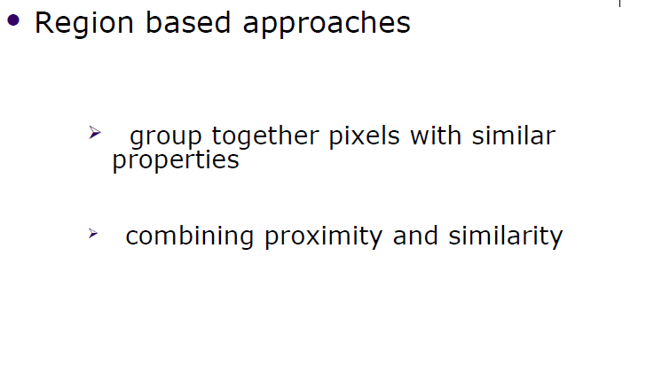

Slide 11
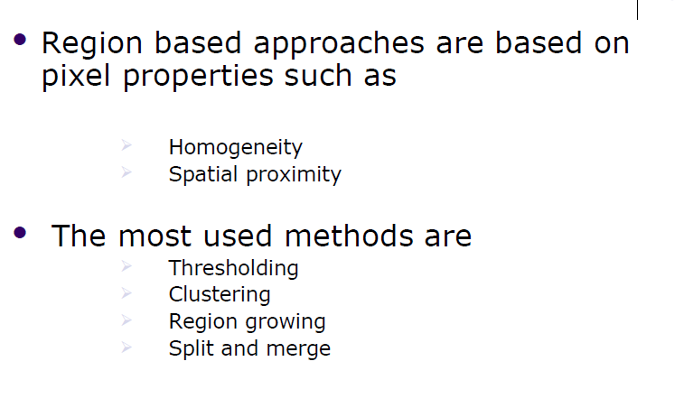

Slide 12
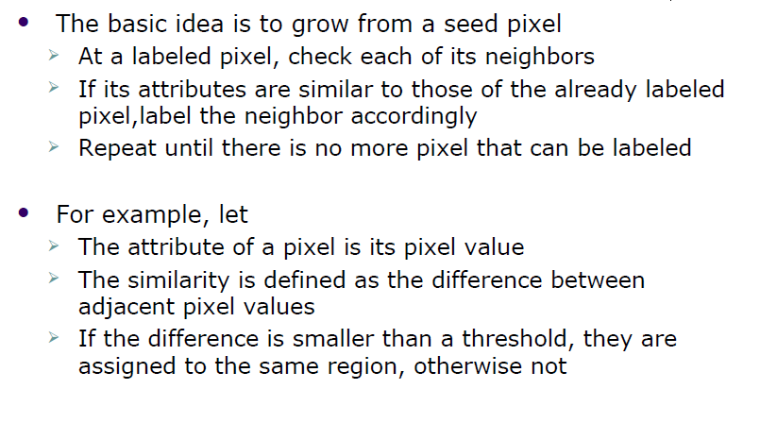
Region Growing/ Pixel Aggregation

Slide 13
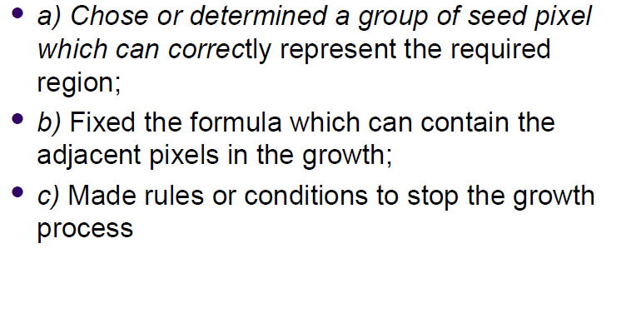
Algorithm for Region Growing

Slide 14
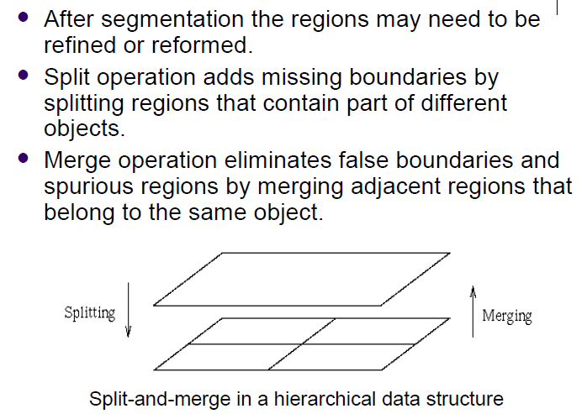
Region Split and Merge

Slide 15
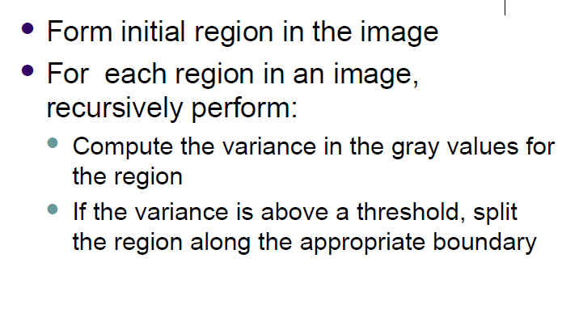
Algorithm for Region Splitting

Slide 16
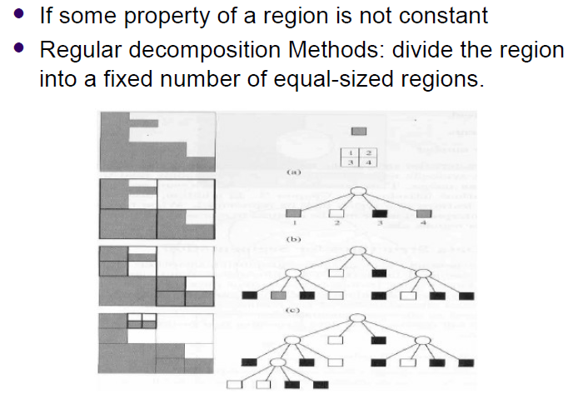

Slide 17
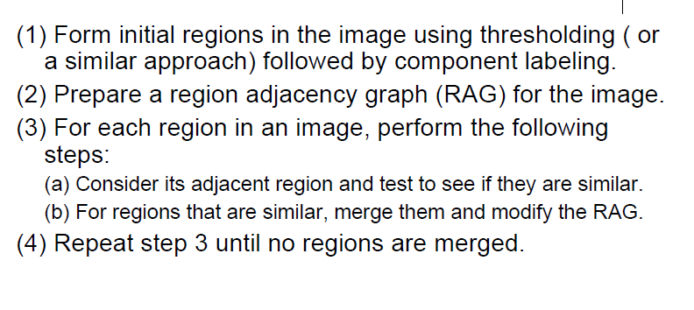
Region Merging Algorithm

Slide 18
Image Thresholding
Image thresholding is a simple,way of partitioning an image into a foreground and background.
This image analysis technique is a type of image segmentation that isolates objects by converting gray scale images into binary images.
Image thresholding is most effective in images with high levels of contrast.

Slide 19
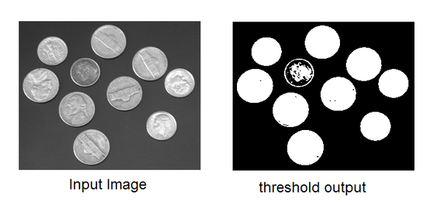
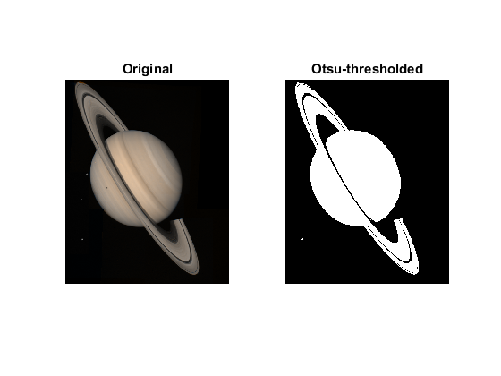

Slide 20
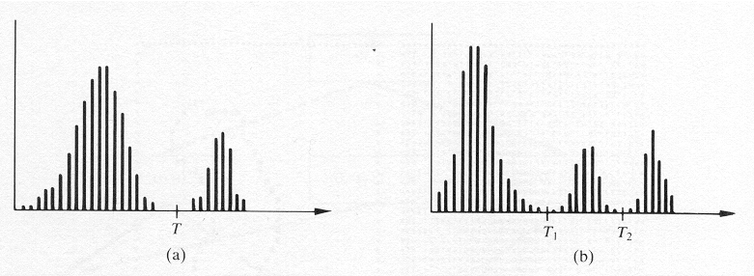
Thresholding
Foundation:

Slide 21
Thresholding
In A: light objects in dark background
To extract the objects:
Select a T that separates the objects from the background
i.e. any (x,y) for which f(x,y)>T is an object point.

Slide 22
Thresholding
In B: a more general case of this approach (multilevel thresholding)
So: (x,y) belongs:
To one object class if T₁<f(x,y)≤T₂
To the other if f(x,y)>T₂
To the background if f(x,y)≤T₁

Slide 23
Thresholding
A thresholded image:
(objects)
(background)

Slide 24
Thresholding
Thresholding can be viewed as an operation that involves tests against a function T of the form:
where p(x,y) denotes
some local property of this point.

Slide 25
Simple Global Thresholding
To partition the image histogram by using a single threshold T.
Then the image is scanned and labels are assigned.
This technique is successful in highly controlled environments.

Slide 26
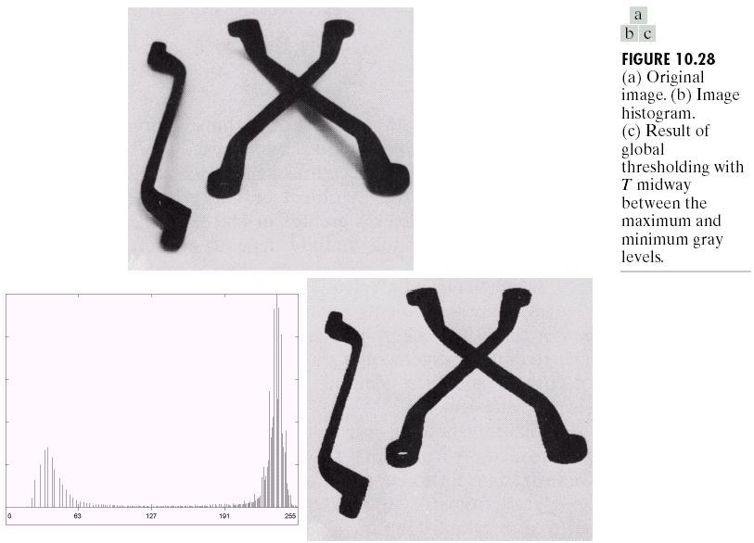
Image Segmentation

Slide 27
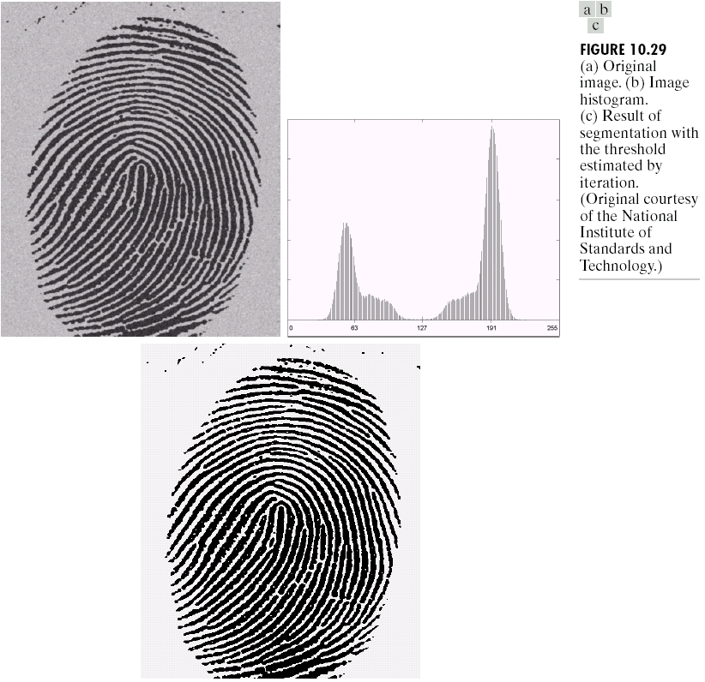
Chapter 10
Image Segmentation

Slide 28
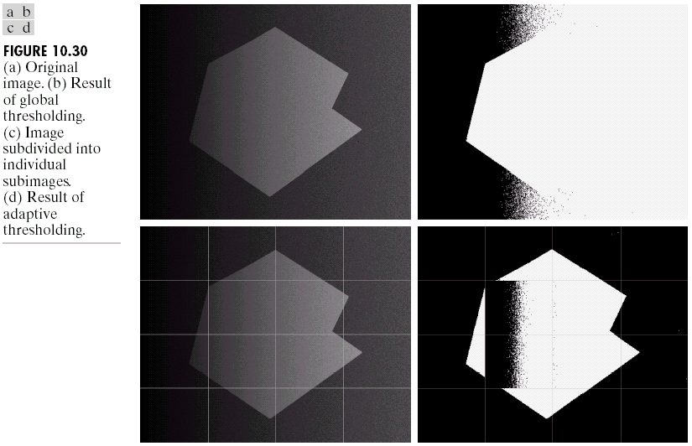
Image Segmentation

Slide 29
Optimal Thresholding
The histogram of an image containing two principal brightness regions can be considered an estimate of the brightness probability density function p(z):
the sum (or mixture) of two unimodal densities (one for light, one for dark regions).

Slide 30
Optimal Thresholding
The mixture parameters are proportional to the areas of the picture of each brightness.
If the form of the densities is known or assumed, determining an optimal threshold (in terms of minimum error) for segmenting the image is possible.

Slide 31
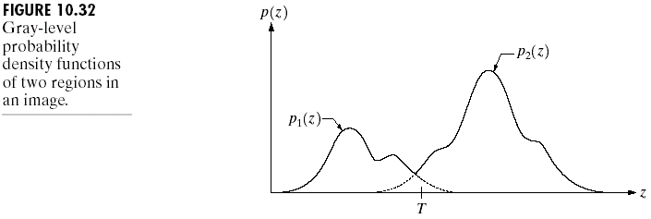
Image Segmentation

Slide 32
Threshold Selection Based on Boundary Characteristics
The chances of selecting a good threshold are increased if the histogram peaks are:
Tall
Narrow
Symmetric
Separated by deep valleys

Slide 33
Threshold Selection Based on Boundary Characteristics
One way to improve the shape of histograms is to consider only those pixels that lie on or near the boundary between objects and the background.
Thus, histograms would be less dependent on the relative sizes of objects and the background.

Slide 34
THRESHOLDING

Slide 35
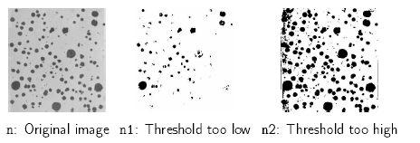
Choosing a threshold: Review
Image thresholding classifies pixels into two categories:
– Those to which some property measured from the image falls below a threshold, and those at which the property equals or exceeds a threshold.
– Thesholding creates a binary image à binarization
e.g. perform cell counts in histological images
Choosing a threshold is something of a “black art”:
n=imread(‘nodules1.jpg’);
figure(1); imshow(n);
n1=im2bw(n,0.35);
n2=im2bw(n,0.75);
figure(2), imshow(n1);
figure(3), imshow(n2);

Slide 36
Optimal Thresholding
• In optimal thresholding, a criterion function is devised that yields some measure of separation between regions.
– A criterion function is calculated for each intensity and that which maximizes this function is chosen as the threshold.
Otsu’s thresholding chooses the threshold to minimize the
intraclass variance of the thresholded black and white pixels.
Formulated as discriminant analysis: a particular criterion function
is used as a measure of statistical separation.

Slide 37
Otsu method minimizes the overall within-class variance by minimizing the weighted sum of class variances

Slide 38



Otsu’s Method
Otsu’s thresholding method is based on selecting the lowest point between two classes (peaks).
Frequency and Mean value:
Frequency: N: total pixel number
Mean: n_{i}: number of pixels in level i
Analysis of variance (variance=standard deviation²)
Total variance:

Slide 39
Otsu’s Method
between-classes variance (δ_{b}² ):
The variation of the mean values for each class from the overall intensity mean of all pixels:
δ_{b}² = ω₀ (μ₀ - μ_{t} ) ² + ω₁(μ₁ - μ_{t} ) ²,
Substituting μ_{t} = ω₀ μ₀ + ω₁μ₁, we get:
δ_{b}² = ω₀ω₁(μ₁ - μ₀ )²
ω_{0,} ω_{1,} μ_{0,} μ₁ stands for the frequencies and mean
values of two classes, respectively.
The between classes variance is the separability measure for the two classes
Notes:
The between classes variance is the separability measure for the two classes

Slide 40
Otsu’s Method
The criterion function involves between-classes variance to the total variance is defined as:
η = δ_{b}² / δ_{t}²
All possible thresholds are evaluated in this way, and the one that maximizes η is chosen as the optimal threshold

Slide 41
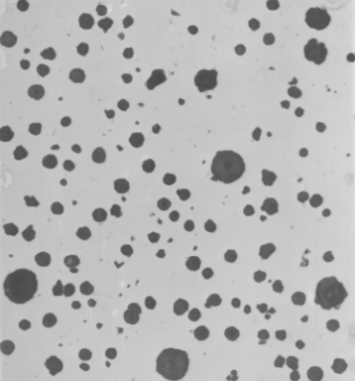

Matlab function for Otsu’s method
function level = graythresh(I)
GRAYTHRESH Compute global threshold
using Otsu's method. Level is a normalized
intensity value that lies in the range [0, 1].
>>n=imread('nodules1.tif');
>> tn=graythresh(n)
tn = 0.5804
>> imshow(im2bw(n,tn))

Slide 42
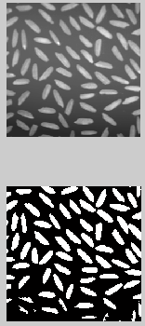
r=imread('rice.tif');
tr=graythresh;
subplot(211);
imshow;
subplot(212);
imshow(im2bw(r,tr))

Slide 43
Hough Transform
Line Detection
Circle Detection

Slide 44
Finding lines in an image
Option 1:
Search for the line at every possible position/orientation
What is the cost of this operation?
Option 2:
Use a voting scheme: Hough transform

Slide 45

Finding lines in an image
y
b
b₀
x
m₀
m
image space
Hough space
Connection between image (x,y) and Hough (m,b) spaces
A line in the image corresponds to a point in Hough space
To go from image space to Hough space:
given a set of points (x,y), find all (m,b) such that y = mx + b

Slide 46

Finding lines in an image
y
b
y₀
x₀
x
m
image space
Hough space
Connection between image (x,y) and Hough (m,b) spaces
A line in the image corresponds to a point in Hough space
To go from image space to Hough space:
given a set of points (x,y), find all (m,b) such that y = mx + b
What does a point (x₀, y₀) in the image space map to?
A: the solutions of b = -x₀m + y₀
this is a line in Hough space

Slide 47

Hough transform algorithm
Typically use a different parameterization
d is the perpendicular distance from the line to the origin
θ is the angle this perpendicular makes with the x axis
Why?

Slide 48
Hough transform algorithm
Typically use a different parameterization
d is the perpendicular distance from the line to the origin
θ is the angle this perpendicular makes with the x axis
Why?
Basic Hough transform algorithm
Initialize H[d, θ]=0
for each edge point I[x,y] in the image
for θ = 0 to 180
H[d, θ] += 1
Find the value(s) of (d, θ) where H[d, θ] is maximum
The detected line in the image is given by
What’s the running time (measured in # votes)?

Slide 49
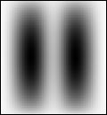
Watershed Algorithm
Watershed Segmentation gets its name from the manner in
which the algorithm segment regions into Catchement basins
The term watershed refers to a ridge that divides areas drained by different river systems. A catchment basin is the geographical area draining into a river or reservoir.
The watershed transform requires that you think of an image as a surface
If you imagine that bright areas are "high" and dark areas are "low," then it might look like the surface (left). With surfaces, it is natural to think in terms of catchment basins and watershed lines.

Slide 50
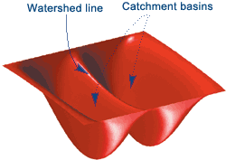
The key behind using the watershed transform for segmentation is this: Change your image into another image whose catchment basins are the objects you want to identify.
Steps in Watershed Algorithm:
Read in an Image and covert it in grayscale
Use the gradient magnitude as the segmentation function
Mark the foreground objects
Compute the Background markers
Compute the watershed transform of the segmentation function
Visualize the result.

